Slide 1


New-York City, hospital-beds capacity and Covid-19
Exploring the Neighborhoods & Boroughs in New-York City that are the best equipped to fight the Covid-19 Pandemic

Slide 2

Background
The Coronavirus disease 2019 (COVID-19) is an infectious disease caused by severe acute respiratory syndrome coronavirus 2 (SARS-CoV-2). The disease was first identified in December 2019 in Wuhan, the capital of China's Hubei province, and has since spread globally, resulting in the ongoing 2019–20 coronavirus pandemic. As of 29 April 2020, more than 3.13 million cases have been reported across 185 countries and territories, resulting in more than 217,000 deaths.
Within this context, all countries have been hit, with some Regions of the World more or less severely impacted. New-York City in the US is one of the cities that have been strongly hit, with a death toll of approximately 12,509 as of today (out of a total of 58,864 deaths in the US) according to the WHO statistics.

Slide 3
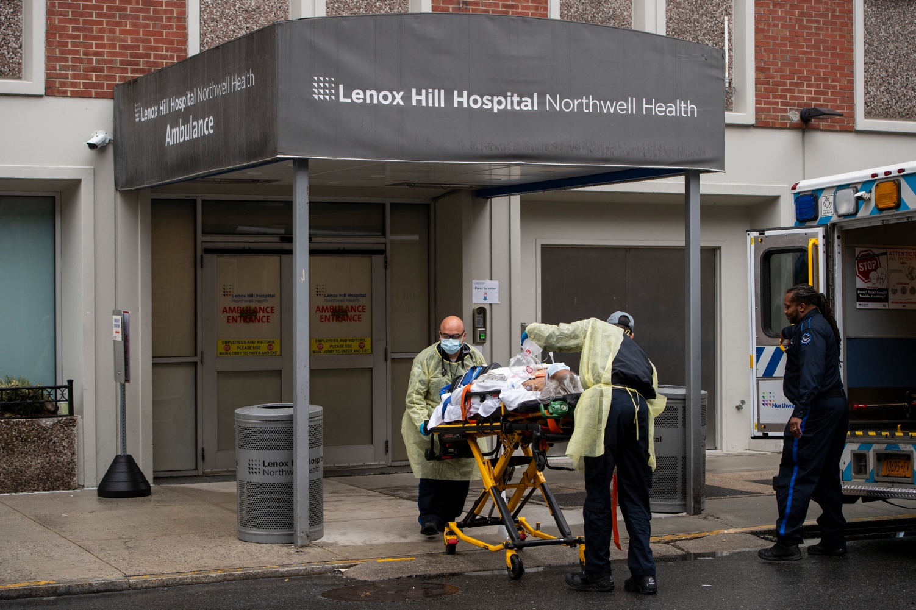
Problem Statement
Hospitals across the state “have been urgently looking to expand capacity in advance of the continuing surge in the number of coronavirus patients and officials said they are planning to possibly shift confirmed virus patients from hospitals with dwindling numbers of available beds to hospitals elsewhere in the state” (ctmirror.org).
At the time of writing this report (April 29th 2020) the situation has improved, but experts are dreading a second wave of infections. Within this context, it is important to have a closer overview of the neighborhoods in New-York City that are the best prepared to welcome infected patients and to fight against this pandemic, by looking at the hospital bed capacity at each neighborhood. To complete this analysis, I will also look at the cases of infected people by neighborhood in order to be able to compare with the hospitals bed capacity

Slide 4


Target Audience
Medical and non-medical experts and analysts from the US Department of Health and Human Services (HHS) working for the City of New-York.
This study will give them a clear understanding of hospitals bed capacity at the different neighborhoods of NY City. The comparison with the number of infected cases at each neighborhood will give a better comprehension in the handling of the Covid-19 pandemic at the neighborhood level. This would also be helpful for making future predictions and for adopting a better crisis management approach in case of a second Covid-19 wave

Slide 5

Analytic Approach
Collect the data about New York City.
Collect the data about New-York City population for each neighborhood.
Collect the data about the number of infected people for each neighborhood.
Use the Foursquare API to get the list of hospitals at each neighborhood.
Collect the hospital bed data.
Perform Data Visualization statistical analysis.
Analyze data by Clustering (using K-Means technique).
Find the best value of K.
Visualize the neighborhood max density of hospital beds per 100 people.
Visualize the neighborhood max density of hospital ICU beds per 100 people.
Look at the number of infected people at each neighborhood and compare with the hospitals bed capacity at each neighborhood, along with some visualizations.
Provide feedback, draw conclusions and open on future implications or questions for research.

Slide 6

Data Collection
New York city data: from Json file: https://cocl.us/new_york_dataset
Population data for each neighborhood: Wikipedia: https://en.wikipedia.org/wiki/Neighborhoods_in_New_York_City
List of hospitals at each neighborhood: through the Foursquare API.
Hospital bed data: from the NYS Health Profile: https://profiles.health.ny.gov/hospital/index#5.79/42.868/-76.809
List of confirmed Covid-19 cases by Borough: Wikipedia: https://github.com/nychealth/coronavirus-data/blob/master/boro.csv

Slide 7
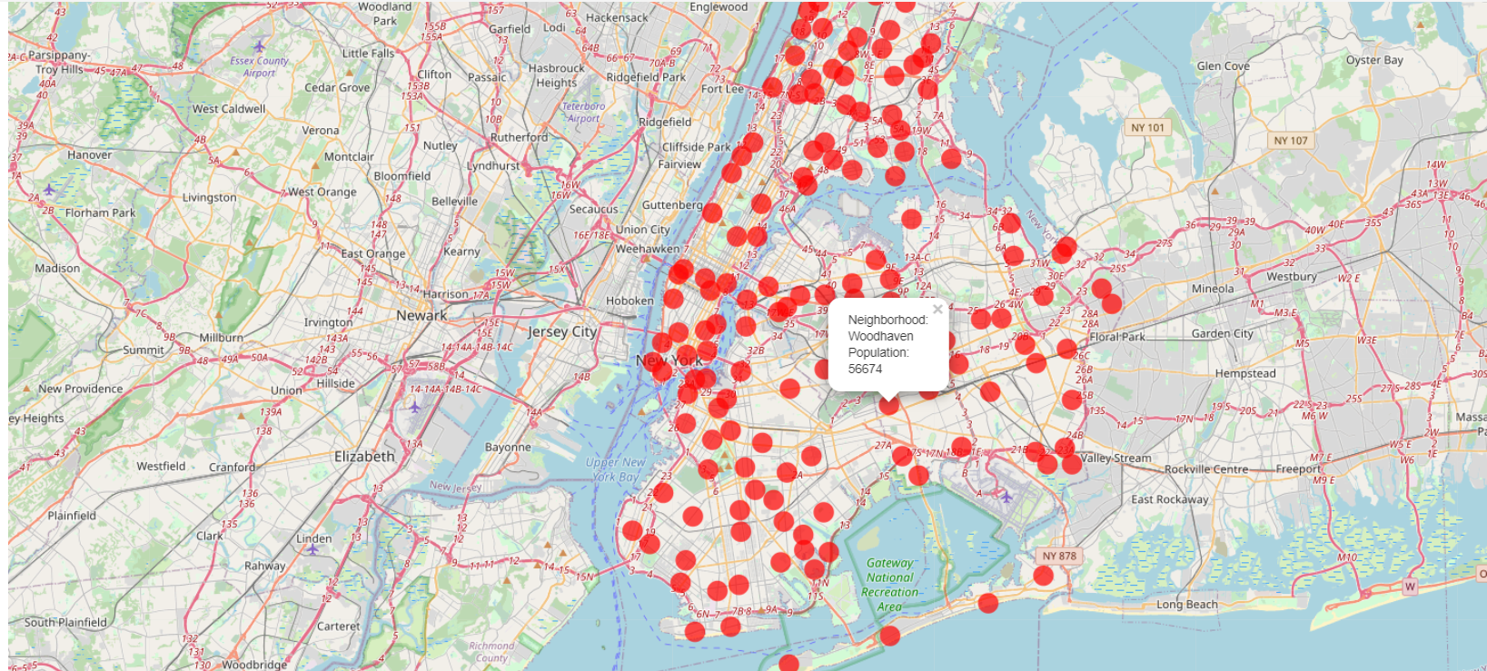
Methodology
1. Population Data: New-York City Population per Neighborhood

Slide 8
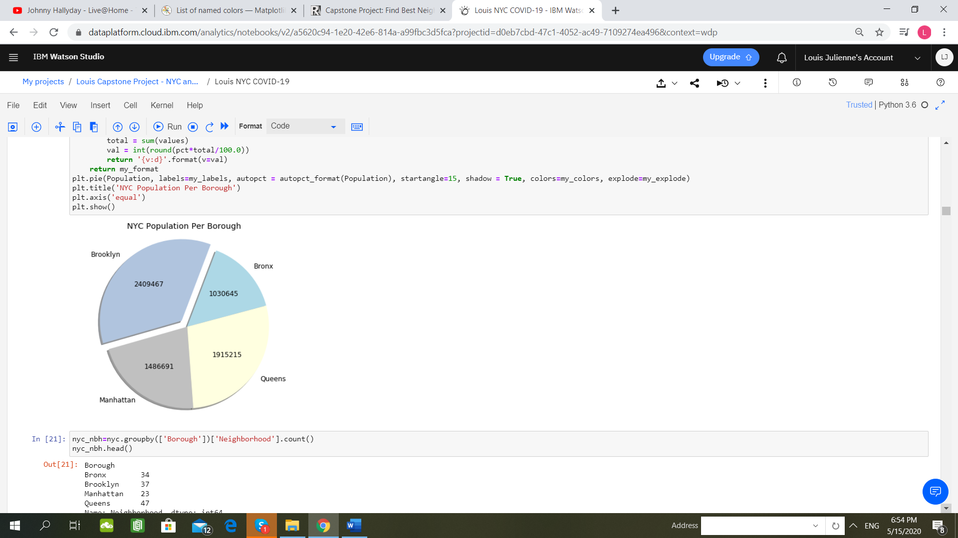
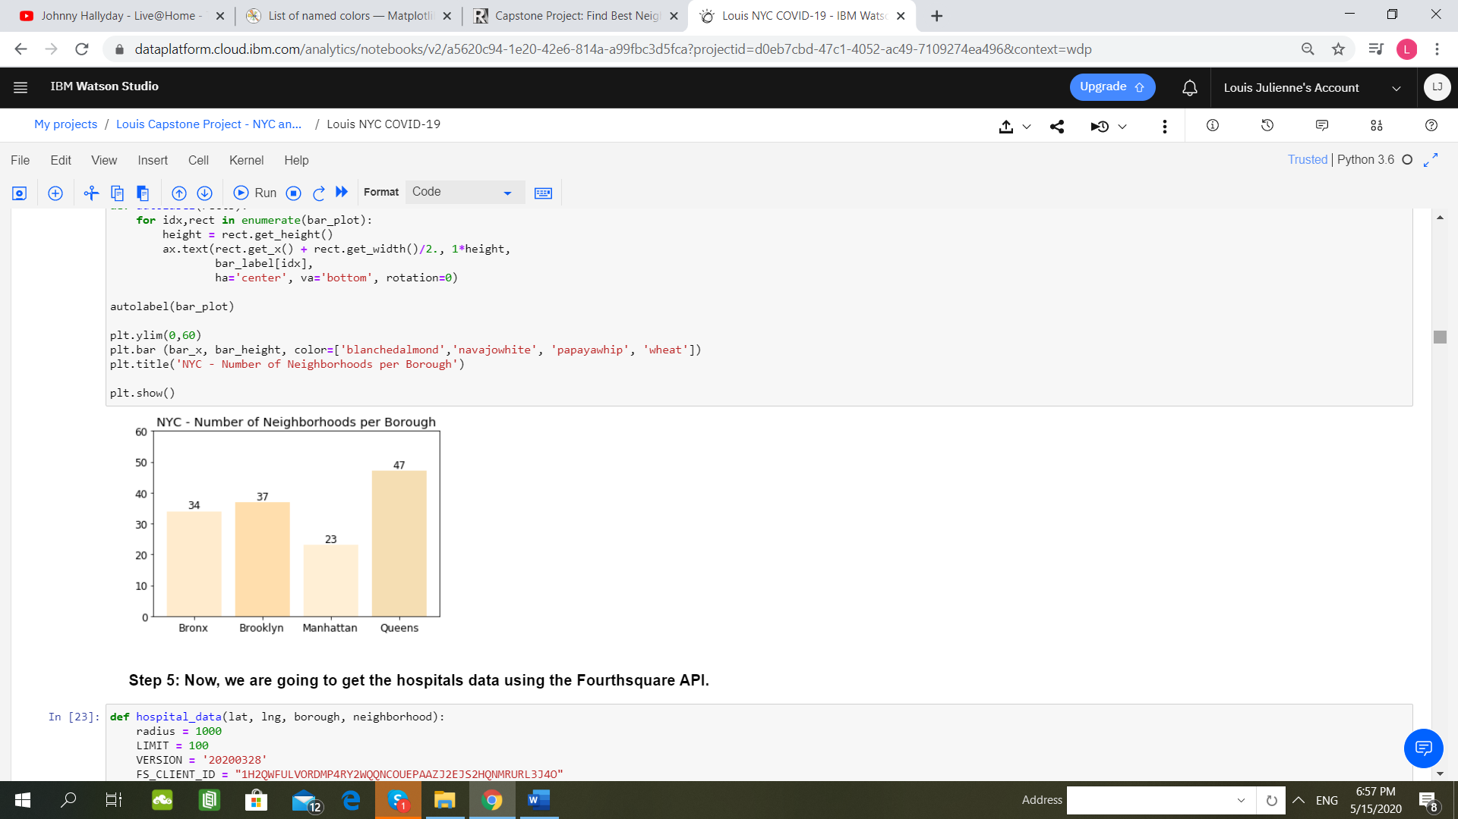
Methodology
2. Population Data: closer look at Boroughs and Neighborhoods
Highest Number of Neighborhoods is in The Queens !
Highest Population is in Brooklyn !

Slide 9
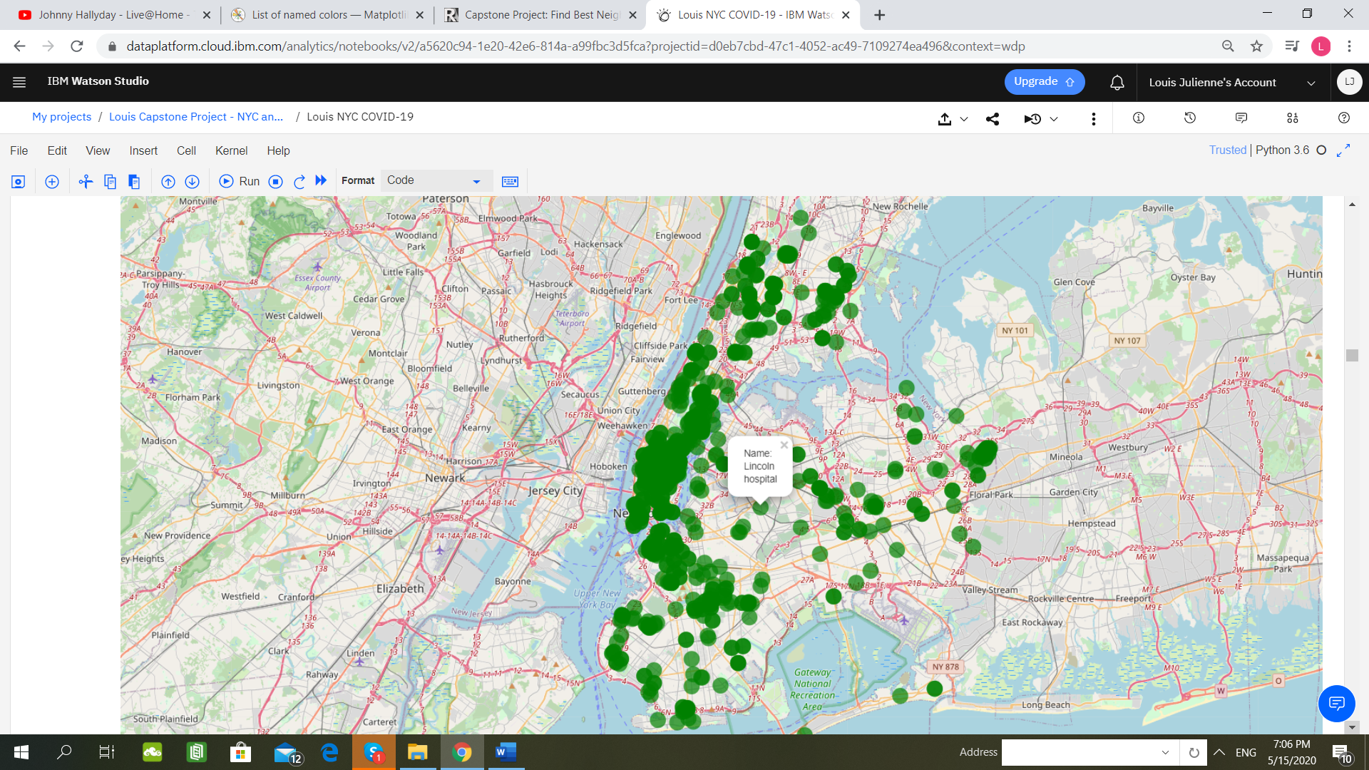
Methodology
3. Hospitals per Neighborhood

Slide 10
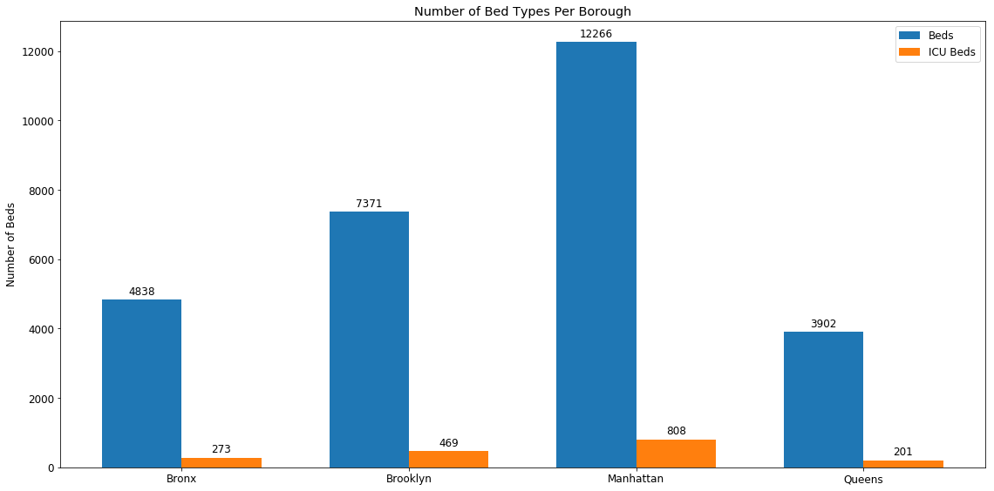
Methodology
4. Bed Types (beds and ICU beds) per Borough
Manhattan: highest number of beds and ICU beds !

Slide 11
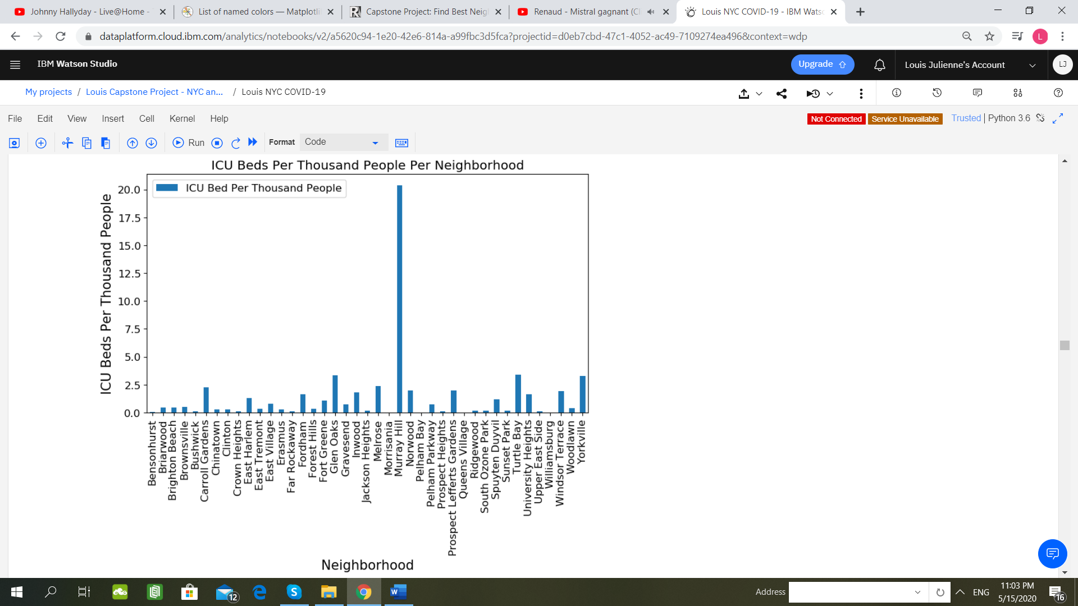
Methodology
5. ICU Beds Number Per Thousand People Per Neighborhood
Queens Village, Williamsburg, Bensonhurst and Crown Heights: lowest number of ICU beds /1000 people !

Slide 12
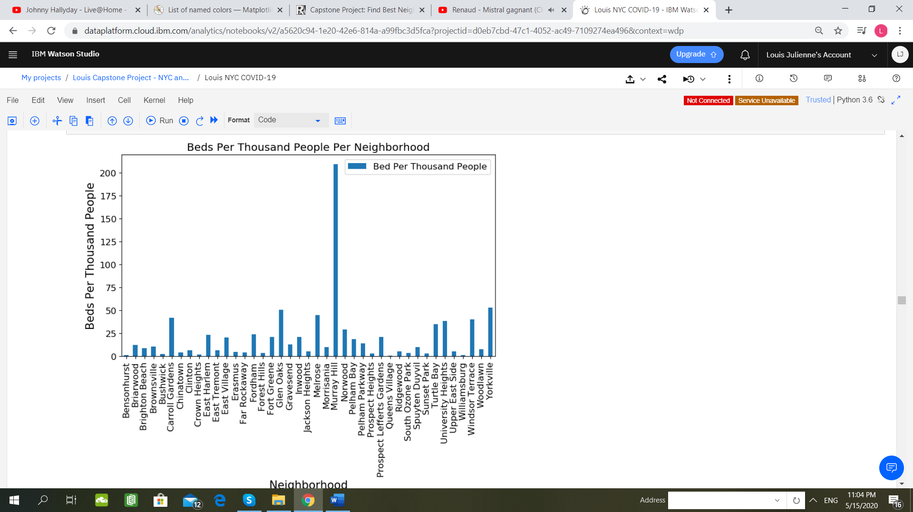
Methodology
Queens Village, Williamsburg, Bensonhurst and Crown Heights: lowest number of beds /1000 people !
6. Beds Number Per Thousand People Per Neighborhood

Slide 13
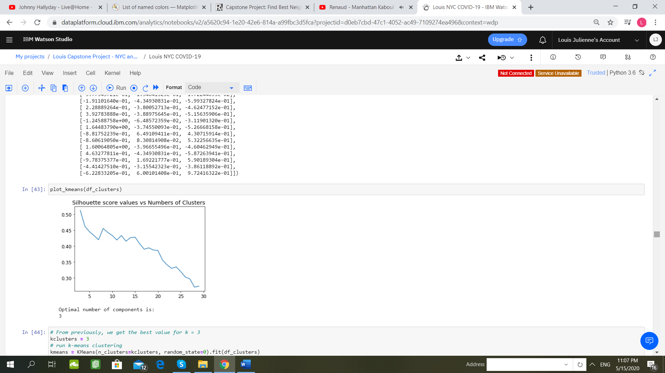
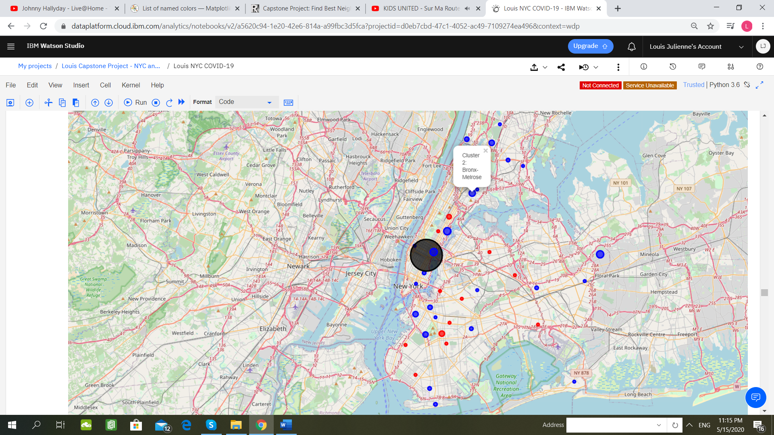
Methodology
7. K-Means Clustering: identifying the best K for representing our clusters of Neighborhoods.
Clusters Map: 1 outsider (in black): Murray Hill in Manhattan !
Best value for K = 3 !

Slide 14
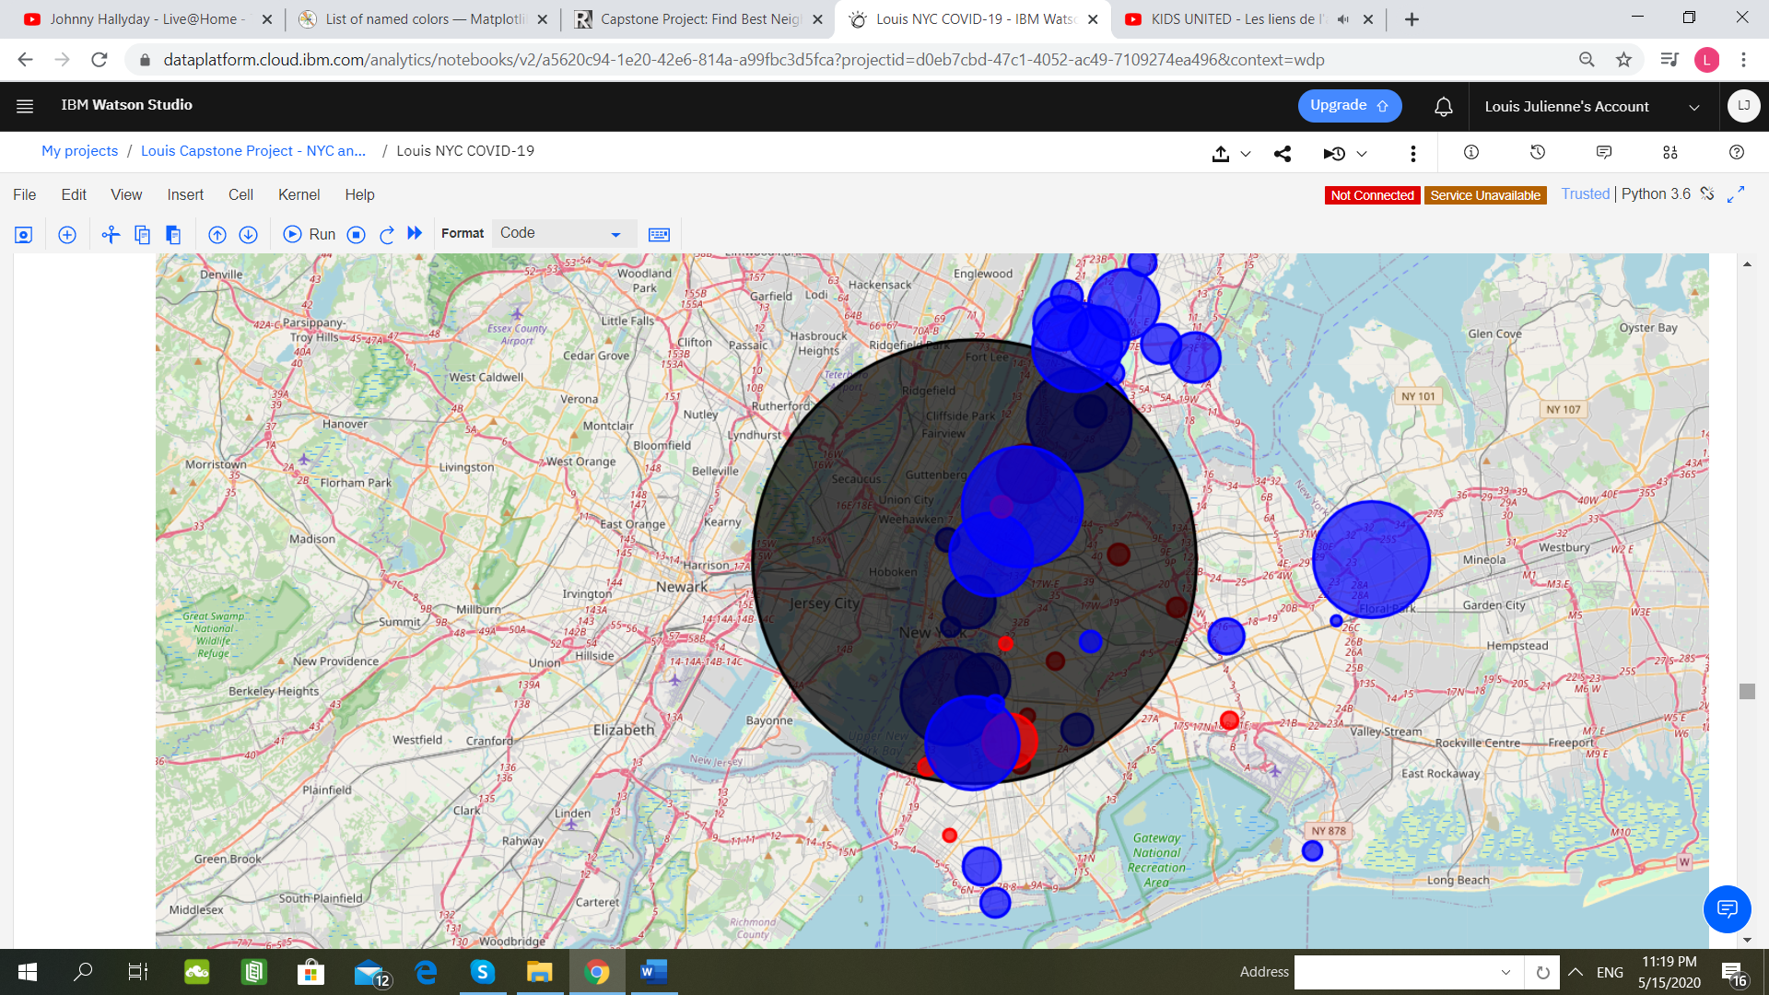
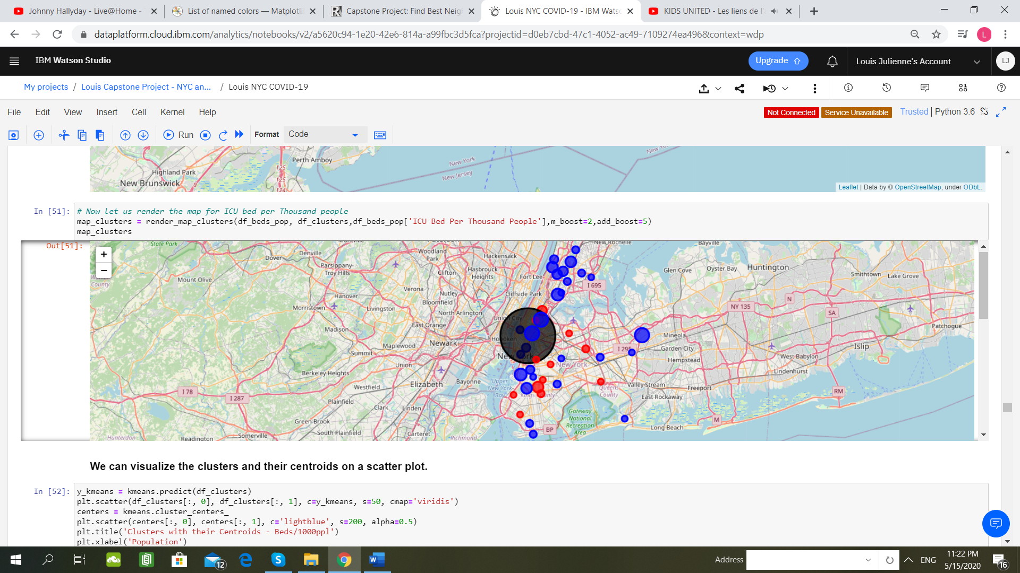
Methodology
7 bis. Representing on a Map the Clusters for the number of beds and ICU beds/1000 people.
The radius of the circle marker is proportional to the number of beds /1000 people!
The radius of the circle marker is proportional to the number of ICU beds/1000 people!

Slide 15
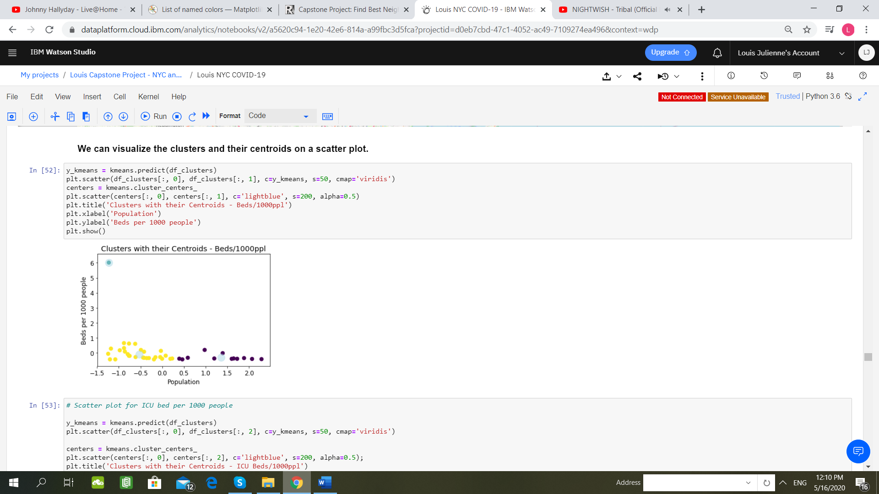
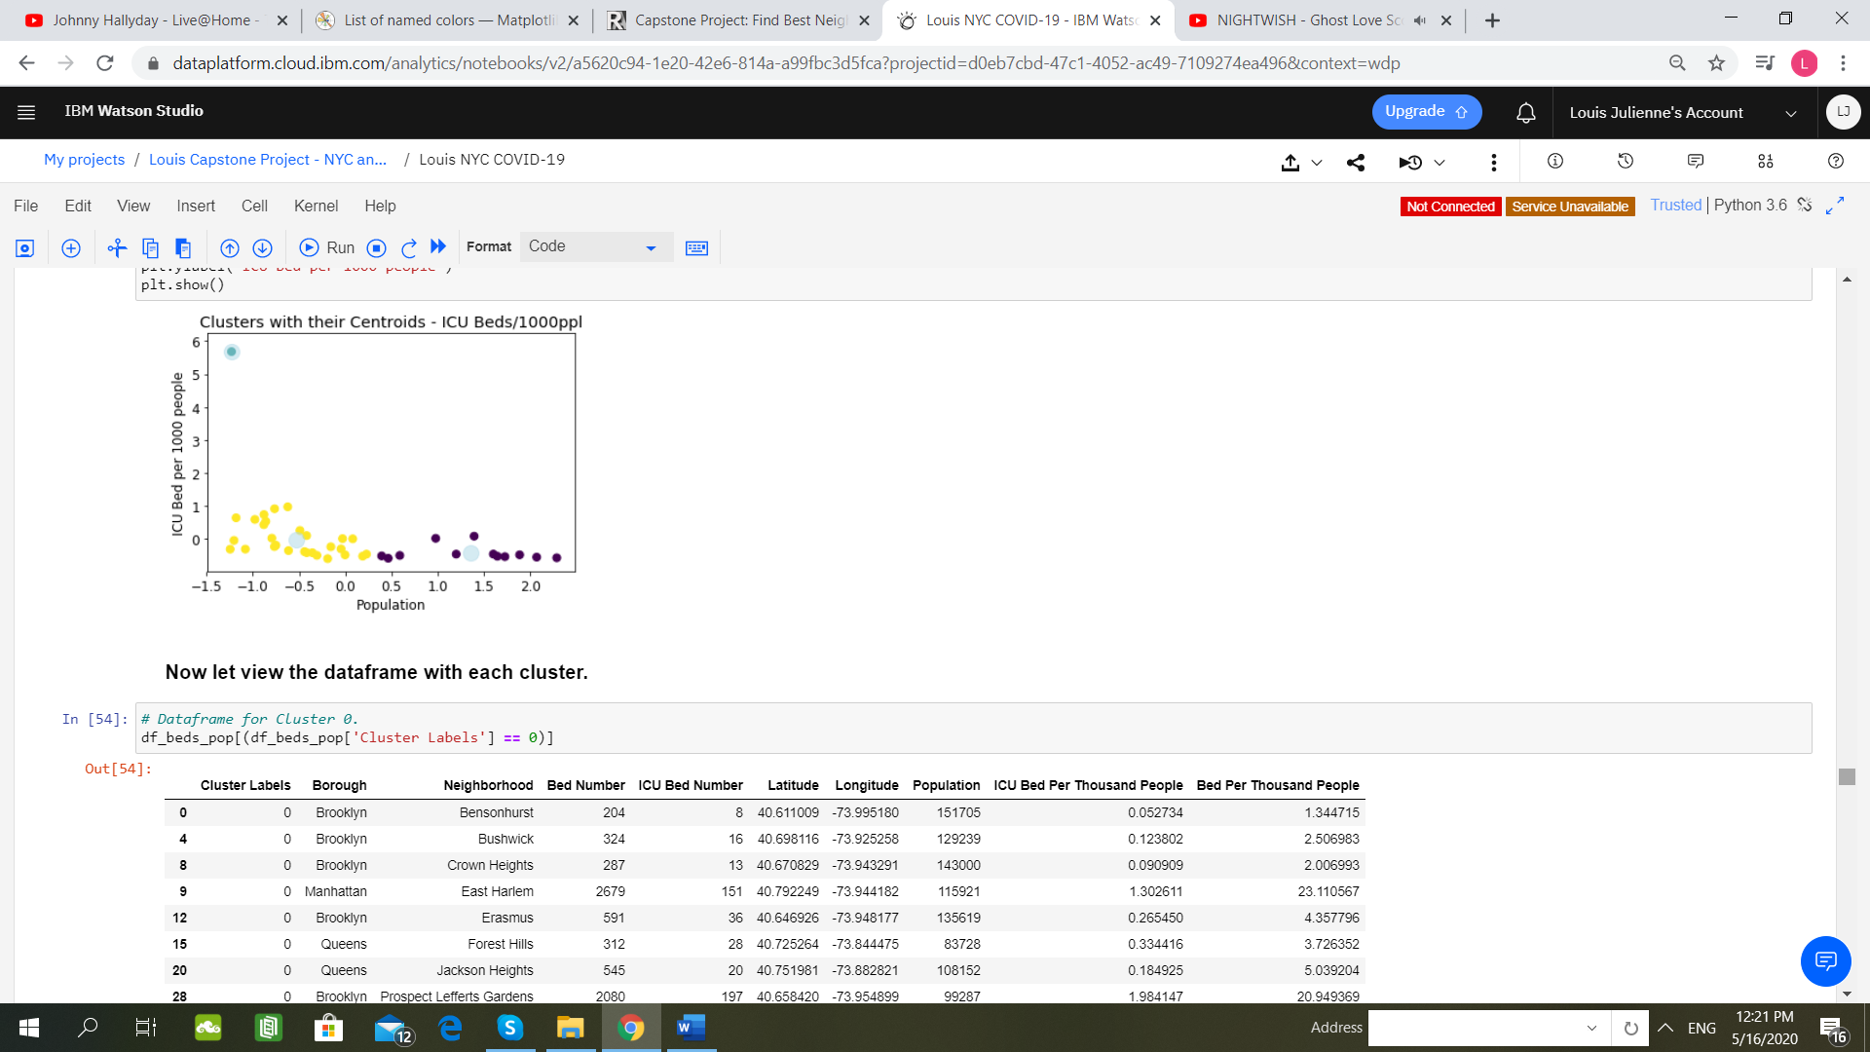
Methodology
7 ter. Clusters and their Centroids.
We can deduct that the outlier (light blue) corresponds to Manhattan, and more specially to the Neighborhood of Murray Hill.
We can deduct that the outlier (light blue) corresponds to Manhattan, and more specially to the Neighborhood of Murray Hill.

Slide 16
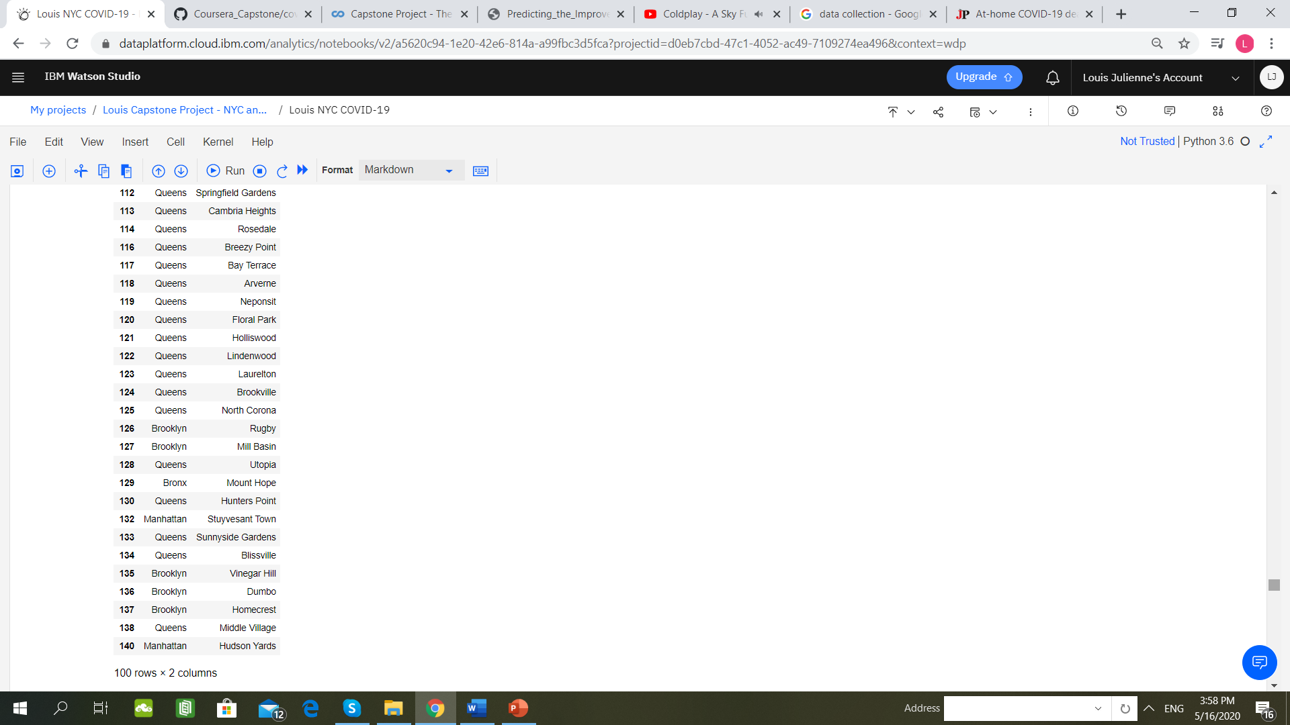
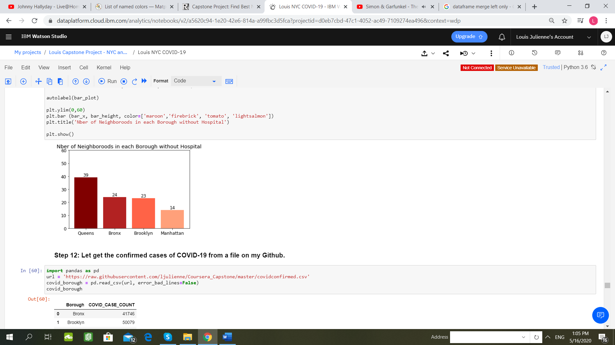
Methodology
8. Neighborhoods without Hospital.
The Queens is the Borough with the highest number of Neighborhoods without Hospital !
100 Neighborhoods without Hospital !

Slide 17
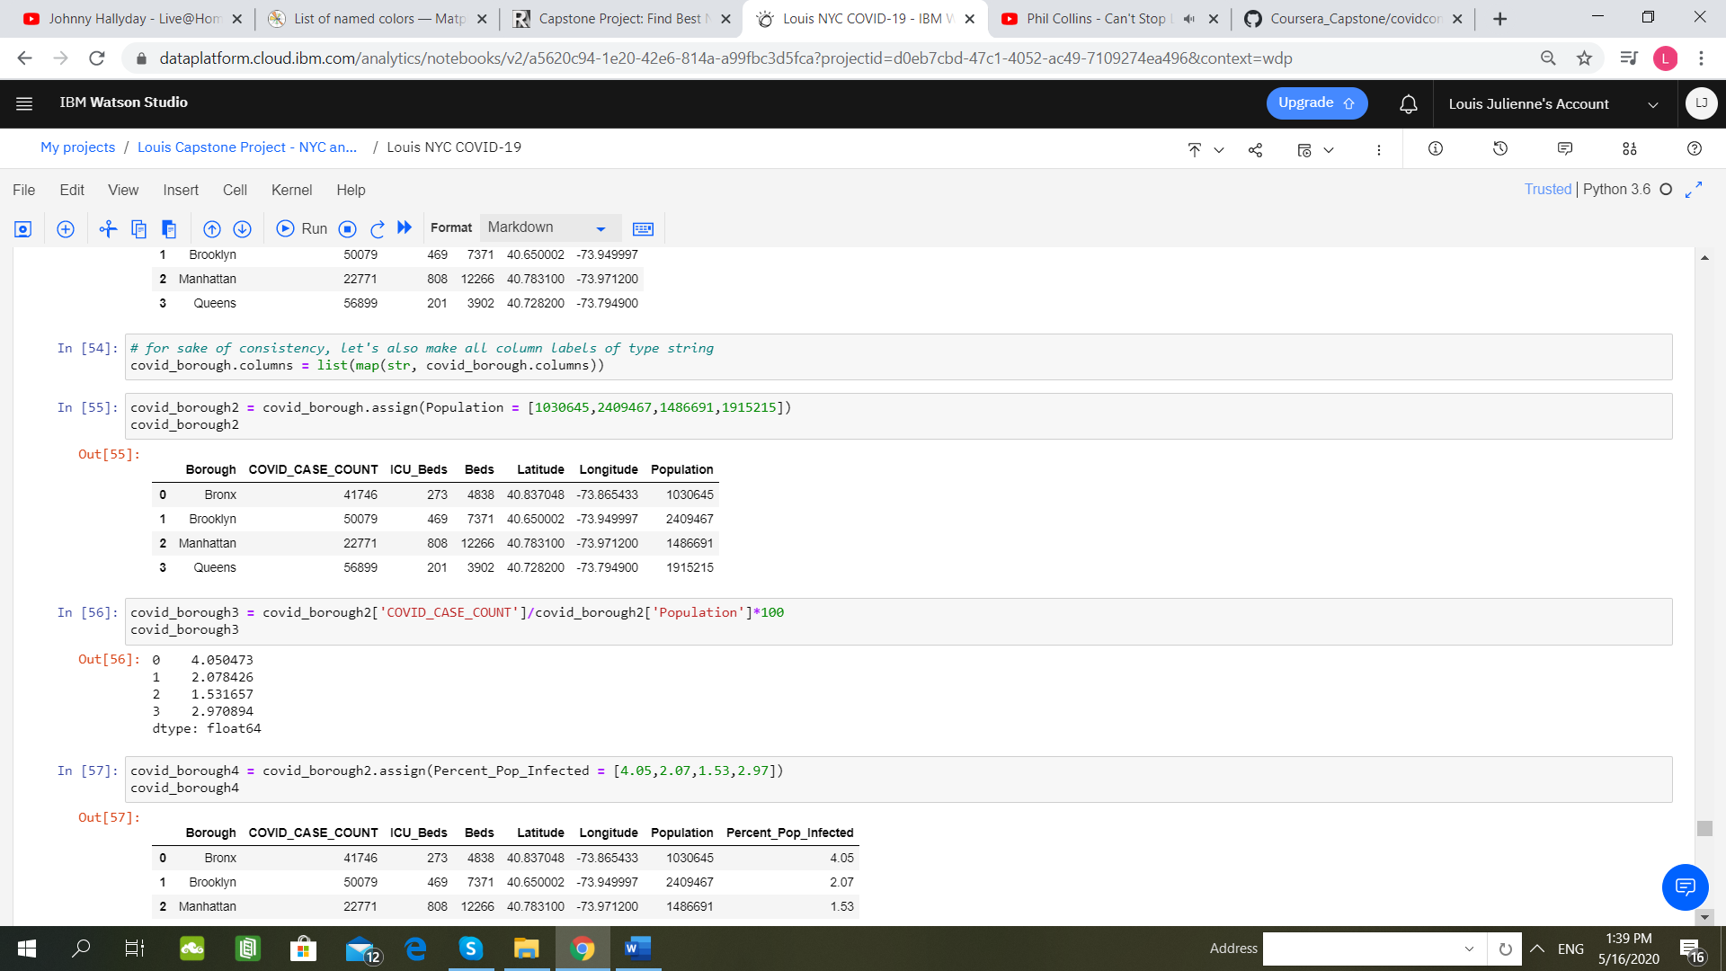
Methodology
9. Number of Covid-19 Infected Cases Per Borough.
The Queens is the Borough with the highest number of positive Covid-19 Cases !

Slide 18
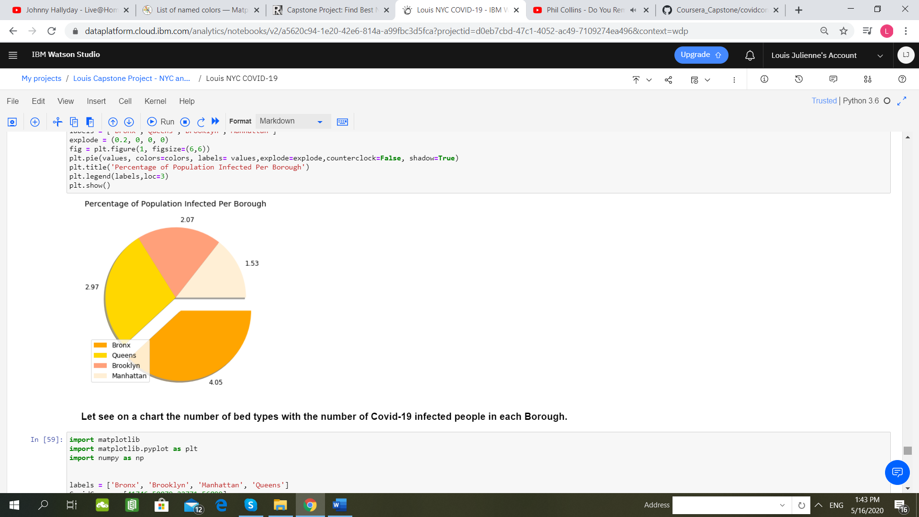
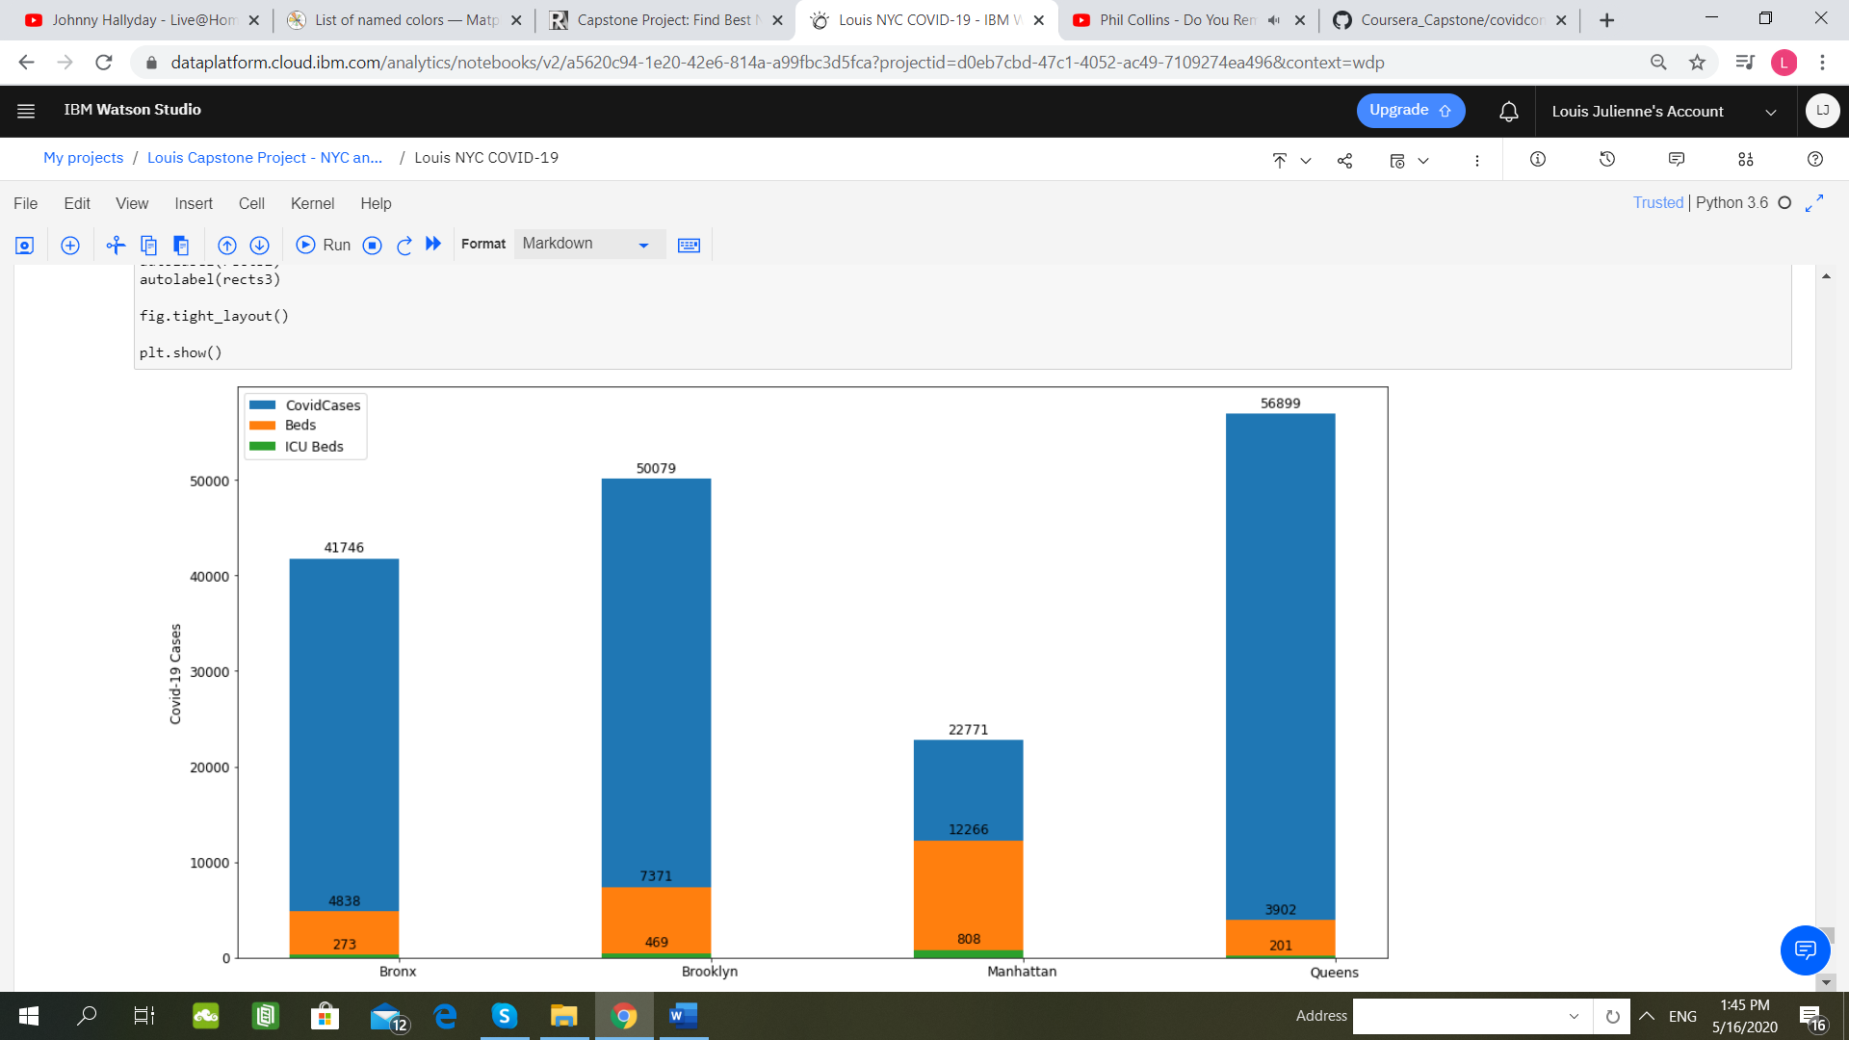
Methodology
9 bis. Number of Covid-19 Infected Cases Per Borough compared to the population in each Borough
Number of bed types with Number of confirmed Covid-19 cases in each Borough
Manhattan seems to be the Borough in the best situation !
The Bronx is the Borough with the highest percentage of its population being infected !

Slide 19
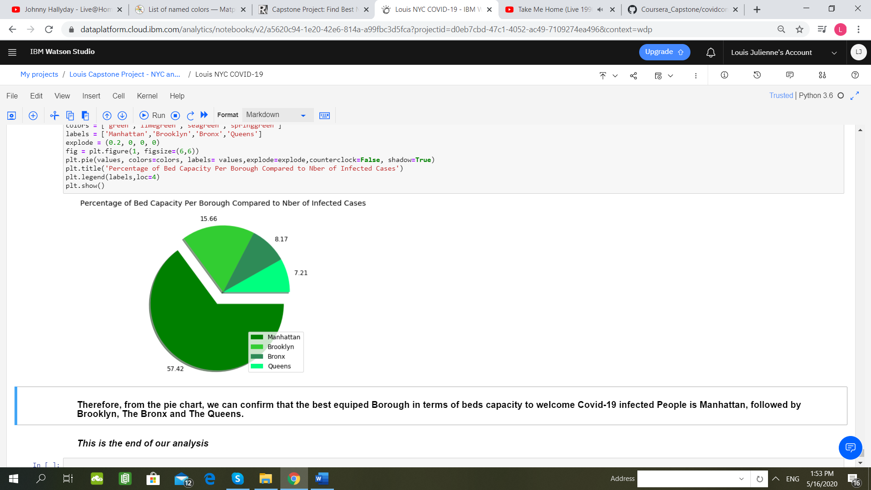
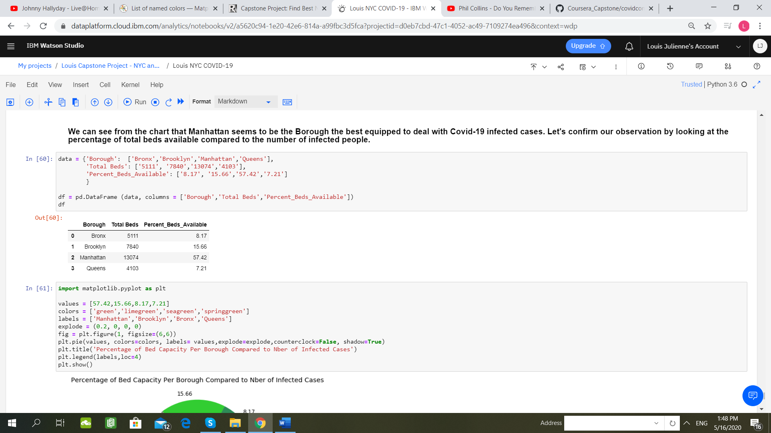
Methodology
9 ter. Confirmation of Previous Observations
Manhattan is indeed the Borough the best equipped in term of hospital-beds capacity in function of number of positive Covid-19 cases, followed by Brooklyn !

Slide 20

Results (1)
During our analysis, we have explored the New-York City data and we have made a comparison with the current number of COvid-19 infected population in order to get better insights. We have seen that New-York City has 4 Boroughs: The Bronx, Manhattan, The Queens and The Queens. We also learned that there are 140 Neighborhoods in these four Boroughs.
We looked at the population per Borough and at the number of Neighborhoods in each Borough. We got the hospital names located in each Borough through the Foursquare API and represented those on a map, in order to be able to better locate them. We realized that there are 41 Neighborhoods that have hospitals but there are 100 Neighborhoods that do not have any hospital: people living in those areas face a highest risk of not being treated. The Neighborhoods without hospital would obviously face a more challenging situation in case of a raise of Covid-19 infected people, and specially the Borough of The Queens, since it is the Borough with the highest number of Neighborhoods without hospital.

Slide 21

Results (2)
Then, we have created clusters using the K-Means method, and we identified 3 clusters with one outsider that is Murray Hill in Manhattan: this is the Neighborhood with the highest hospital-beds capacity and therefore the best equipped Neighborhood to fight the Covid-19 pandemic. The “Cluster 0” is the cluster with the lowest hospital-beds capacity: efforts should be made to provide more beds and equipment in this cluster, otherwise it will face a challenging situation to threat Covid-19 infected people who need to be hospitalized. Additionally, a particular attention should be paid to the Neighborhoods of Queens Village, Williamsburg, Bensonhurst and Crown Heights, because they have the lowest beds per thousand people capacity and the lowest ICU beds per thousand bed capacity.
Then, we focused at the Borough level and we compared data with the number of Covid-19 positive cases in each Borough. We analyzed the percentage of infected people in each Borough, compared to the population in each Borough and we noticed that The Queens is the Borough with the highest number of positive Covid-19 cases but the Bronx is the Borough with the highest number of positive cases compared to its population. Adversely, Manhattan is the Borough with the lowest percentage of positive Covid-19 cases compared to its population. So, Manhattan is in a pretty good situation since it has the lowest number of positive cases and the highest hospital-beds capacity, but The Bronx and The Queens are not in a real good shape since they have a high number of positive cases and a relatively small hospital-beds capacity.

Slide 22
Limitations of this Study
The Covid-19 situation is not static and is always evolving with time, therefore this analysis only represent the situation at a particular instant.
Furthermore, another limitation comes from the data sets that we used: the data set used to collect the data with the New-York City Boroughs include four Boroughs, whereas now there is a new Borough named Staten Island that was not part of the data set. This means that this Borough and its Neighborhoods was not considered for this analysis. And the data with the New-York City population came from a Wikipedia page that might not contain the latest population data.
Another limitation comes from the Foursquare API and the list of hospitals that we obtain from it: we are unsure if all the hospitals are listed in Forusquare, and we might not have the latest hospital list in this analysis.
Also, at the end, we simplified our analysis by focusing on the number of positive Covid-19 cases at the Borough level, because of lack of data at the Neighborhood level. Focusing on the Neighborhood level could have give us a better idea of the local situations and challenges.

Slide 23

Recommendations for Future Research
The first recommendation would be to use up-to-date data sets with the latest information about the New-York City population, total number of Boroughs and hospitals list, as well with the data about the number of Covid-19 infected people in each Neighborhood.
The second recommendation is in regards with the second part of our analysis: it would be more accurate to write a code that is not “static” where we can change the parameters in function of the evolution of the Covid-19 situation. This would give us the exact situation of the pandemic throughout the time, instead of having a picture of the situation at a specific moment, especially by creating sort of “interactive” maps.

Slide 24
Thank You for your Attention !
Louis JULIENNE, may 16th 2020.

